Slide 1
Modeling the Effects of Auditory Neuropathy on the Auditory Brainstem Response
Graham Voysey
Binaural Hearing Lab
M.S. Thesis Defense
18 August, 2016
Notes:
Thanks!
In fine HRC tradition, please interrupt me whenever.

Slide 2
So I can ask this question two ways, but let me ask it this way: What should we leave in? What's the bare minimum we should leave in as we try to understand what's important about the function of the cochlea?
David Mountain, 2014
→ And how can you tell? ←
Notes:
And what I would add …

Slide 3

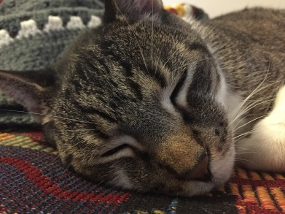
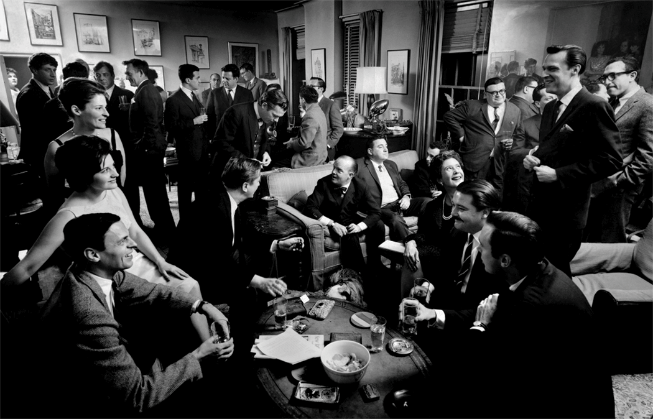
“Hidden Hearing Loss” is common
Hidden Hearing Loss is not diagnosed by standard audiometric threshold testing
Audiometry tests for detection, not discrimination.
Mechanism(s) of HHL currently under debate
No objective diagnostics for loss of discrimination currently exist
Notes:
Part of why no objective test → mechanism not clear.

Slide 4
Potential Causes of HHL
Central Processing Disorder: A polite way of saying “We have no idea. Your ear seems fine; maybe it’s all in your head”
Sometimes, deficits or disorders actually are central (e.g., tinnitus)
Auditory Neuropathy (Cochlear Synaptopathy):
What would peripheral damage that does not affect thresholds or middle ear mechanics, but does affect the fidelity of the transmission of sound from the ear to higher areas look like?
Some Pre-cortical Processing Deficit
Damage at lower levels → “information starvation” at higher levels
Impacts on more complex tasks: object representation, source segregation…

Slide 5
The Big Goals of the Field
Better understand the mechanisms of HHL
Develop an objective test for HHL.
Noninvasive
Minimize psychophysics
Notes:
An obvious tool for this is

Slide 6
Auditory Brainstem Response
Noninvasive
Evoked Response
Large populations
Sensitive to synchrony
Waves correspond to different stages of audition
Wave 1-3: Early Stages
Wave 5: Later Stages
Durrant, 2008
Notes:
So, what did I set out to do

Slide 7
Thesis Aims
Model Human Experiments
Explore The Effects of Changing Models
Relate Modeling to New Experiments
Notes:
All these goals really lead to something new …

Slide 8
A New Modeling Environment
Multiple choices for each stage of the ascending auditory system
Standardized I/O
Framework for large-scale simulations
Easy to keep track of results
Auditable: metadata about each simulation is permanently baked in
Open Source, easy to get up and running
Notes:
Before we really get into that, we need to review the auditory system.
I’ll explain the biology, then walk through the current models of it, and my system together.

Slide 9
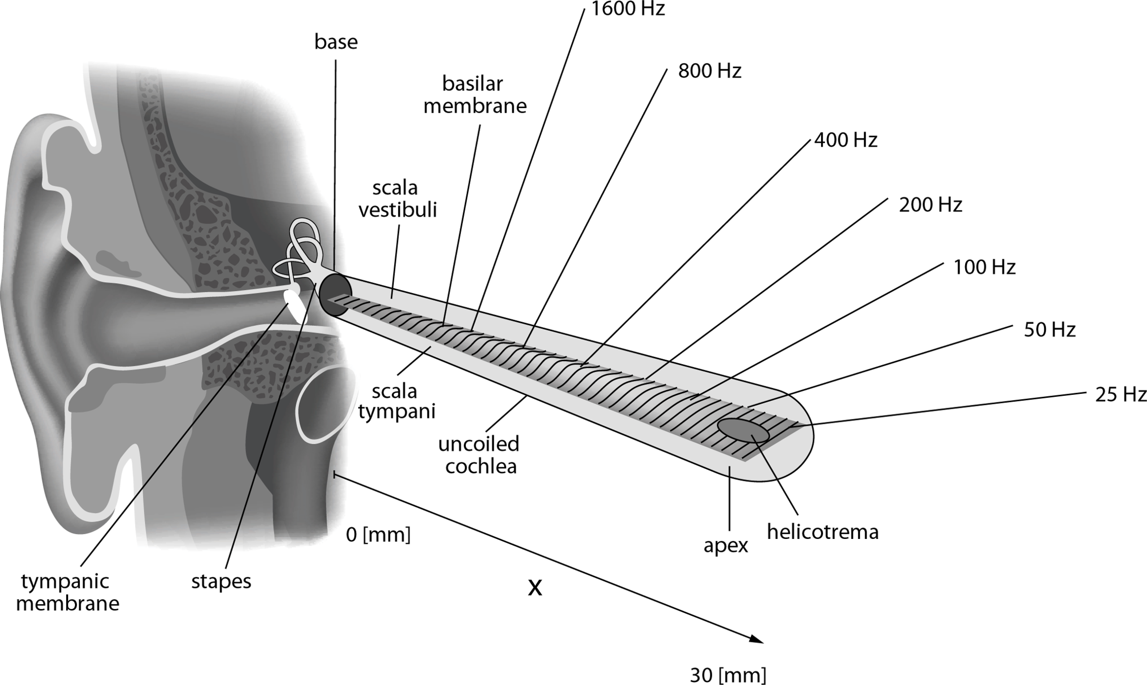
Sound propagates through the Cochlea
Each area of the Cochlea has a Characteristic Frequency (CF)

Slide 10
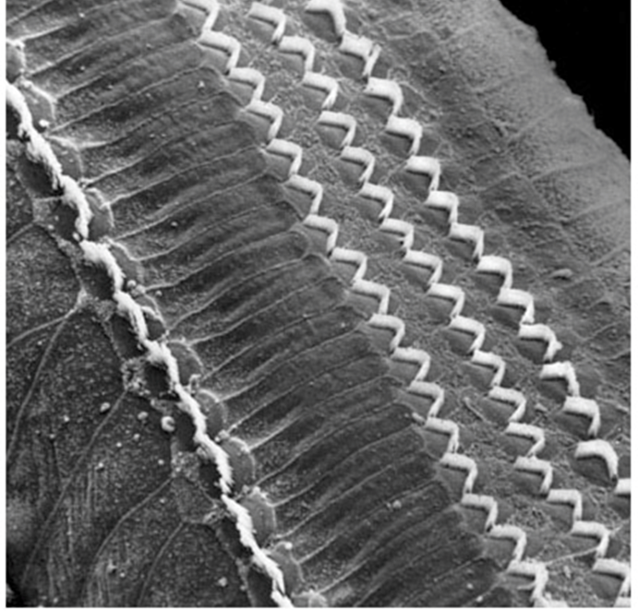
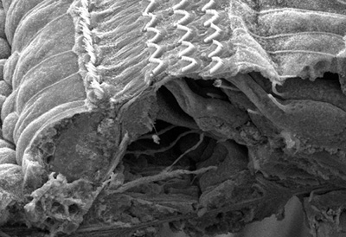
The Organ of Corti is Cool
Notes:
Inner hair cells receive a lot of afferent nerve inputs.

Slide 11
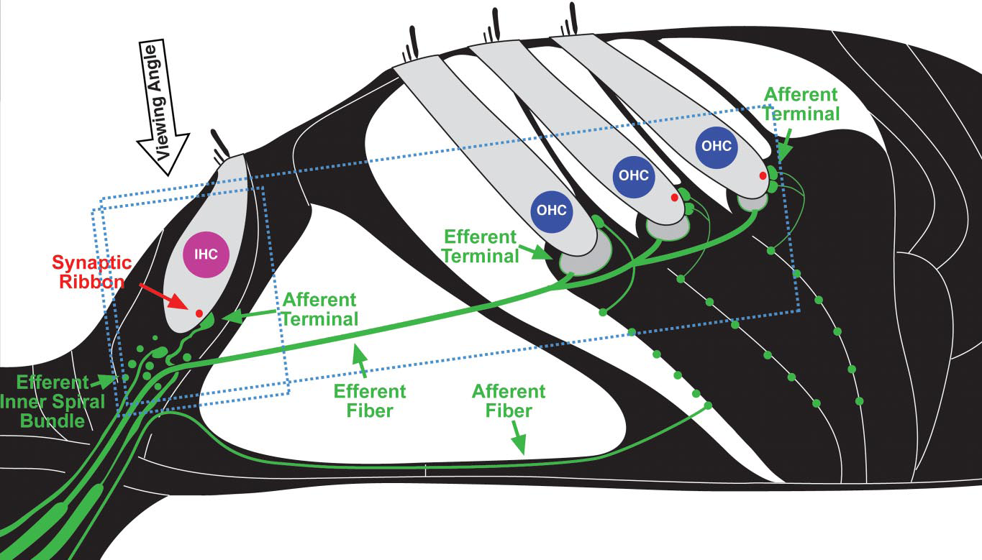
Inner Hair Cells are Important
Kujawa & Liberman (09), Hudspeth (14)
Notes:
Basilar Membrane motion → Spikes on AN fibers
Beginning of tonotopic organization
Many fibers per IHC
Fibers have two (or three) categories according to their spontaneous firing rate

Slide 12
Auditory Nerve Fibers
Many fibers synapse onto each Inner Hair Cell (IHC)
Each ANF carries information about BM motion as a series of spikes.
Loss of ANFs are thought to contribute to HHL
CFs become under-represented ? Loss of phase locking? Early saturation → loss of data in the code
Fibers differ in their spontaneous rates (SR)
Low SR fibers have high thresholds, saturate at higher levels
High SR fibers have low thresholds, but saturate at lower levels
In general, more High SR fibers along the cochlea than Low SR fibers.
AN is putative origin of ABR Wave I
Notes:
So what happens when things go wrong?
Classic model of hearing loss → hair cell death.

Slide 13
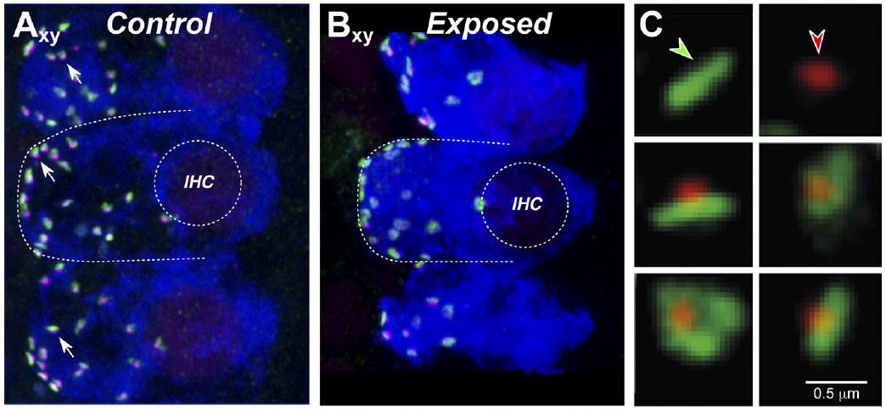
Synaptopathy Precedes Cell Death
Noise exposure that causes a Temporary Threshold Shift (or just Age!) → Deafferentiation of the IHC months or years before hair cell death (ABRs, thresholds remain normal)
Notes:
Further, there’s some evidence for selectivity.

Slide 14
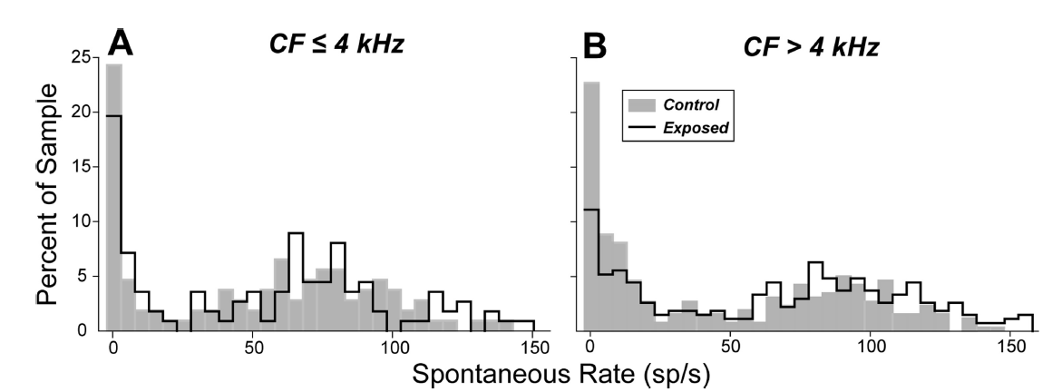
Damage Selects for Low-SR Fibers?
Furman (13)
Low-SR Fibers seem to be particularly vulnerable (Furman, 2013), especially at high frequencies
If so, then this could be a starting place for HHL-like perceptual problems → Low SR fibers preserve our dynamic range at high intensities.

Slide 15
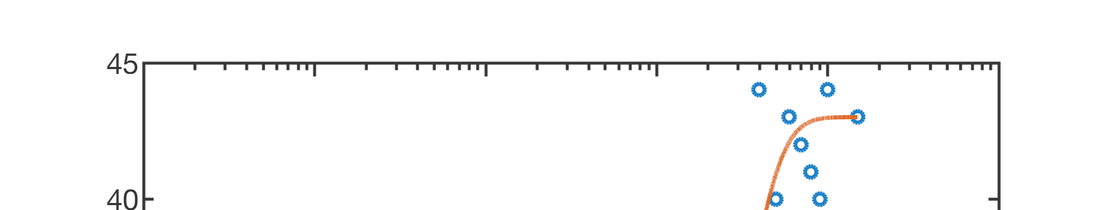
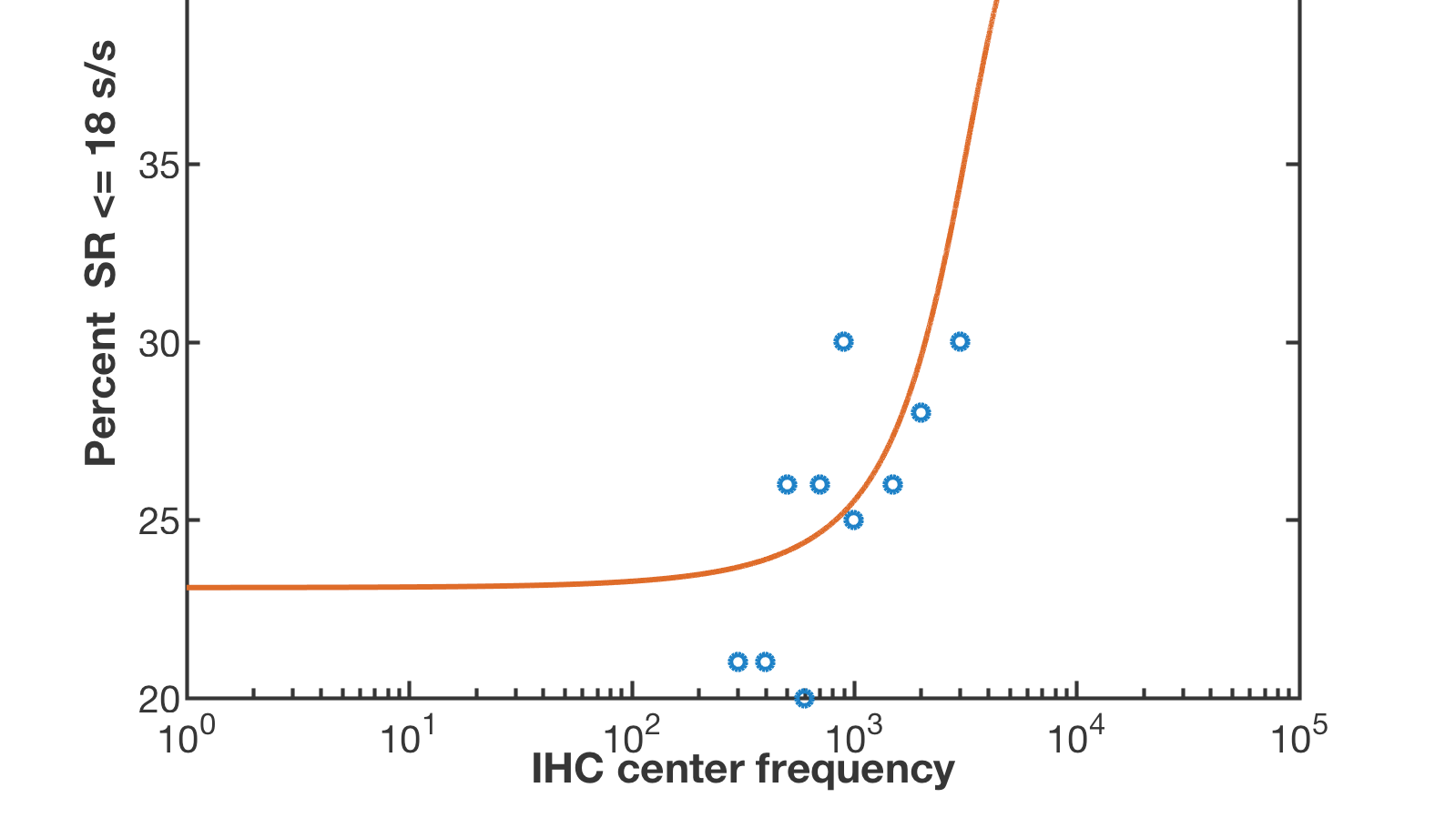
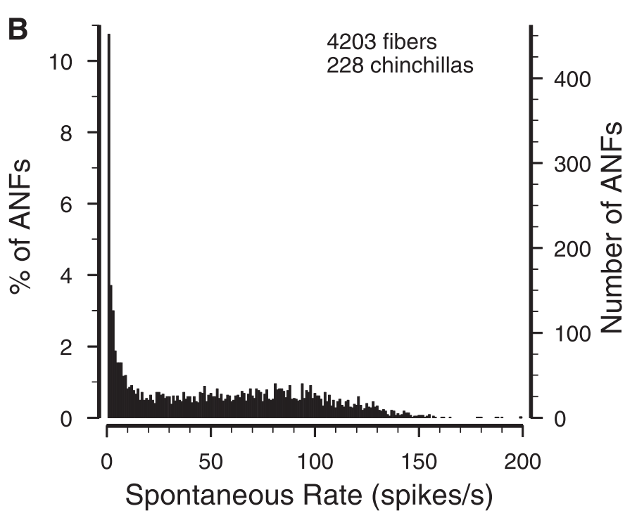
Fiber type Distribution along the BM
Recent evidence for a nonuniform distribution of spontaneous rate fiber types per IHC.
More low-SR fibers at high CFs.
Distribution changes abruptly at ~ 2.5 kHz (in chinchilla)
→ Interesting consequences for HHL
→ Synchrony disruption? Loss of phase locking?
Temchin, Ruggero (2008)
Notes:
OK. So, where does all this go to next?

Slide 16
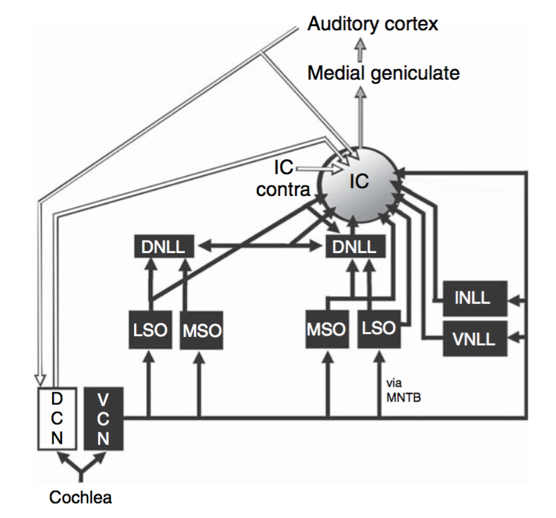
Auditory Nerve Ascending Projections
Auditory Nerve projects to the Cochlear Nucleus (CN)
Brainstem
Dorsal and Ventral areas have special roles
Putative source of ABR Wave III
CN projects (eventually) to the Inferior Colliculus (IC) (Midbrain)
Midbrain
Putative source of ABR Wave V
IC is very complicated
AN concerned with high-fidelity data transmission
Higher areas start doing more computation
Kaas and Hackett, 2008
Notes:
And computation with compromised givens is likely to be wrong.

Slide 17
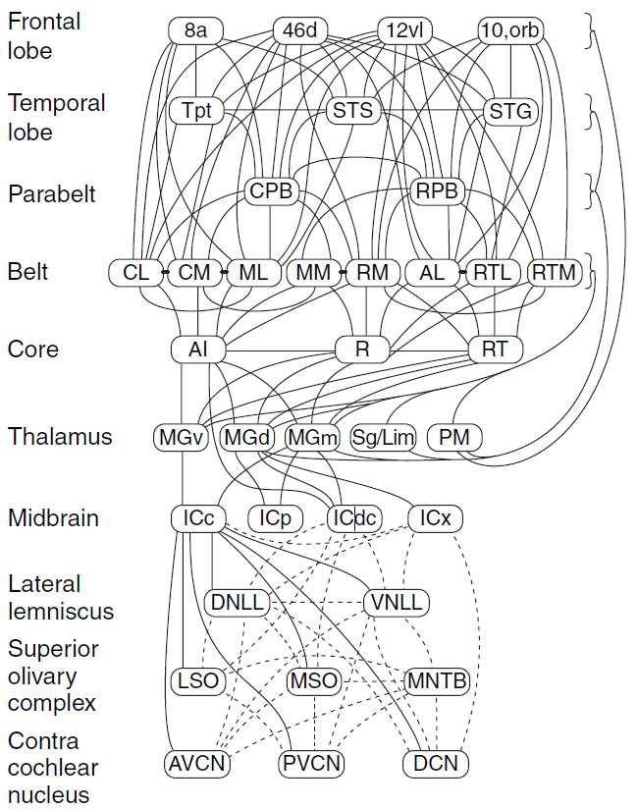
Ascending Projections are Many
Above IC is Thalamus, then Auditory Cortex
Then it gets really complicated.
Efferent feedback not shown (sometimes not known)
If we’re interested in an objective diagnostic, we can probably stop at IC.
Notes:
Great. So, how do we model all of this in a coherent fashion?

Slide 18
Modeling the Auditory Pathways
Many choices of models for this complicated system.
What makes a “good” model?
Does it let us ask better questions?
Does it tell us anything about the biology?
Not interested in a model for everything.
How do we know what model answers the question “better”?
Need to account for parameter choices to compare results and test models inside their ranges
Need to do bookkeeping
→ There’s a need for a better modeling framework.
Notes:
When I started studying this area, I quickly discovered there were a LOT of modeling approaches.

Slide 19
Corti
Open source, Python3
Hosted on GitHub
Citeable by DOI
Already being used by others
Multiple choices for each stage of the ascending auditory system among leading models
Any sound stimulus is OK
Choice of fixed- or sigmoidally-weighted SR distribution
Prelim. synaptopathy models
Output: ABR estimate, as well as all the data along the way.
Choice of parameters → Trajectories (in 6D)
Notes:
So let’s go through this stage by stage.

Slide 20
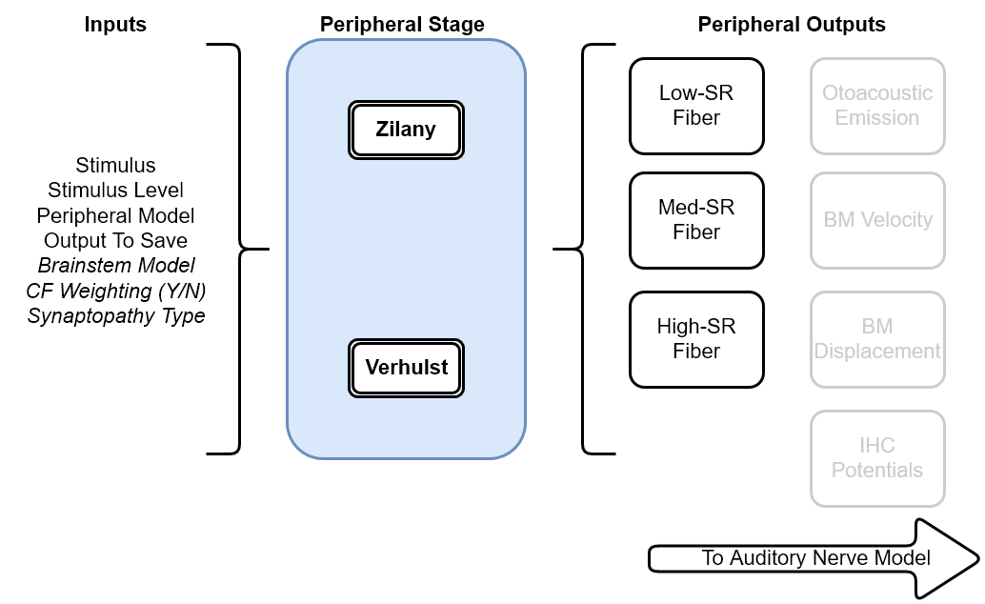
Models of the Cochlea

Slide 21
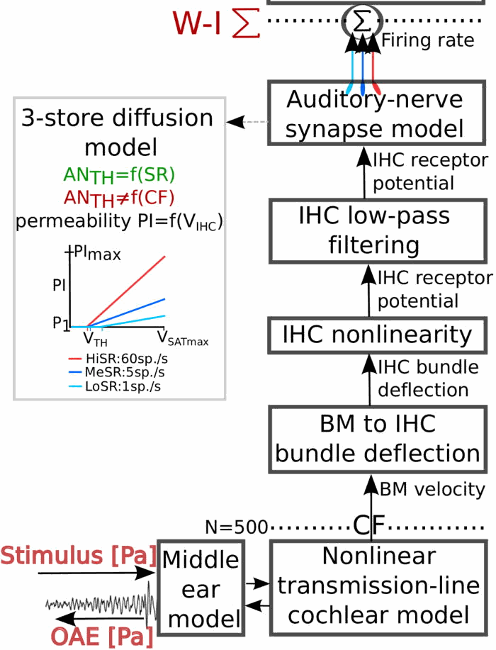
Verhulst Model
Transmission-Line BM model
One IHC per CF
Estimates Instantaneous Firing Rate (IFR) for low- and high- SR fibers
Deterministic
3-store diffusion model varies by CF, SR.

Slide 22
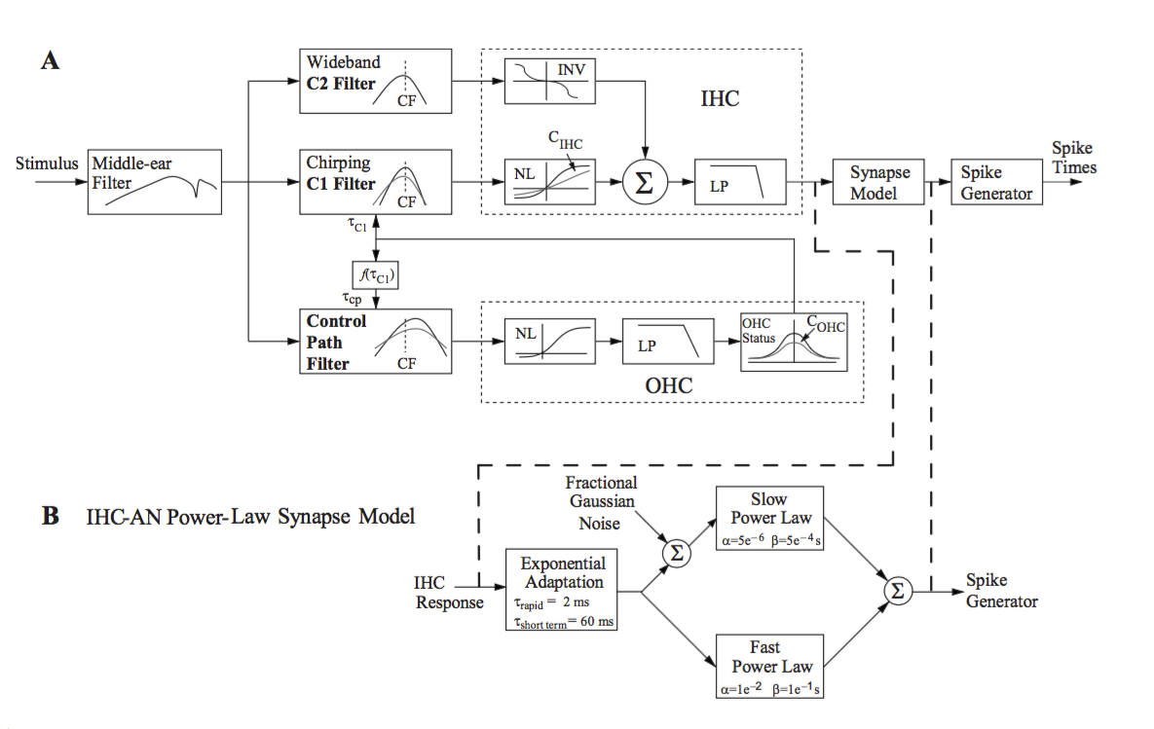
Zilany Model
Phenomenological
Optional Gaussian jitter for each fiber
Refined over time to add new features
Power law adaptation
High levels OK
Speech optimization
One IHC per CF
Notes:
Both Zilany and Verhulst models → One fiber per type per CF.
But that’s not how the AN is set up!

Slide 23
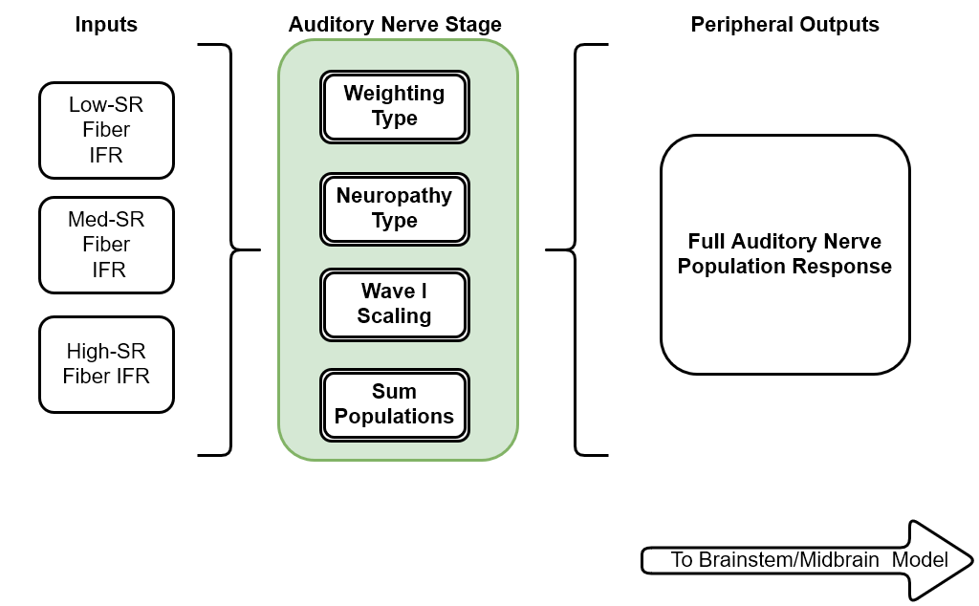
Models of the AN Response

Slide 24
Model Normalization
Assign multiple fibers to one IHC
Linearly or sigmoidally.
Verhulst model is scaled so that an 80dB SPL click stimulus produces an ABR Wave I amplitude of 15 muV.
Linear scaling factor applied to summed AN output
A similar weighting factor was found for the Zilany model through brute force.
→ Zilany and Verhulst output can be compared
Notes:
Apples to oranges, not shoes.

Slide 25
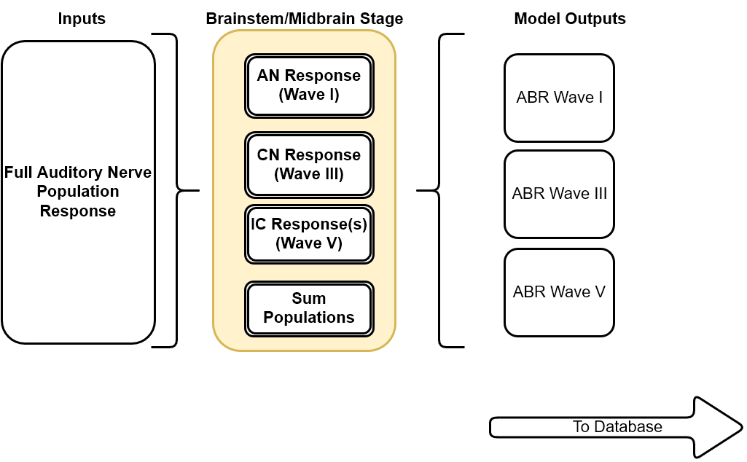
Models of the Brainstem and Midbrain
Notes:
Normalization here, too, for Wave III and V.

Slide 26
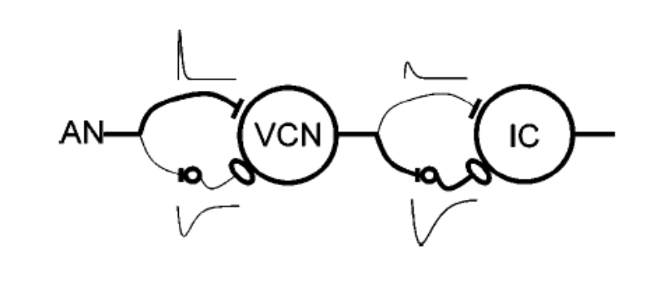
Nelson-Carney (2004)
DCN
Same-Frequency Inhibition/Excitation (SFIE) model
Two alpha functions define excitation and inhibition forces for each CF
Tuneable parameters: Time delay, Amplitudes.
Acts like a digital filter.
CN, IC both Bandpass.

Slide 27
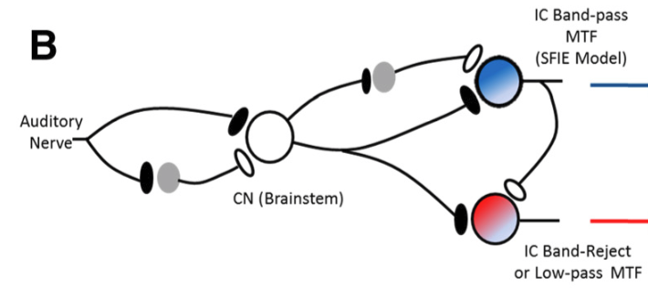
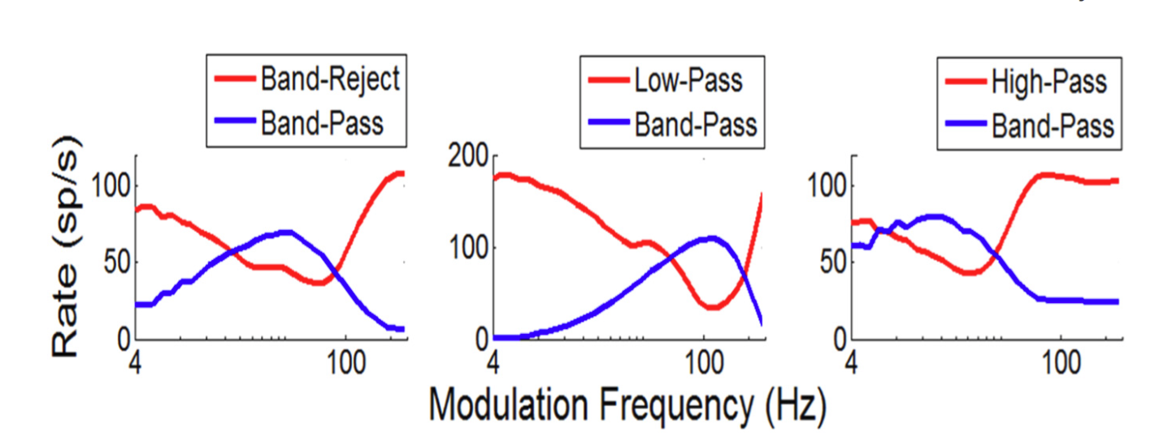
Carney (2015)
Extends prior model with new IC parameters from new EP recordings
Tuned for complex tones, SAM tones, speech-like
CN is still bandpass
IC is bandpass, band-reject, low-pass.

Slide 28
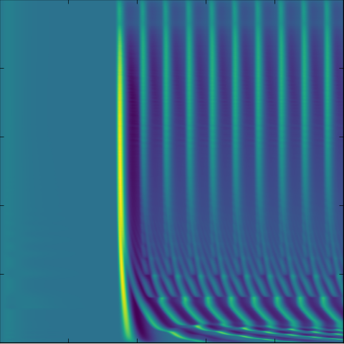
Overall Model Output
Wave I, III, V
Incremental data from each stage (Pop. Resp.)
Saved to disk
0 Log Freq (Hz) 20e3
0 Time(s) 3
→What about comparing different trajectories?

Slide 29
Large-scale simulation management!
Standardized I/O : HDF5
Easy to compare relative effects of models between runs
Easy to design experiments and track results
Build figures by querying a database
Metadata about each simulation is permanently baked into output.
Notes:
So that’s the general framework. What about HHL?

Slide 30
Back to HHL …
Notes:
Remember, there’s been a search for a diagnostic.

Slide 31
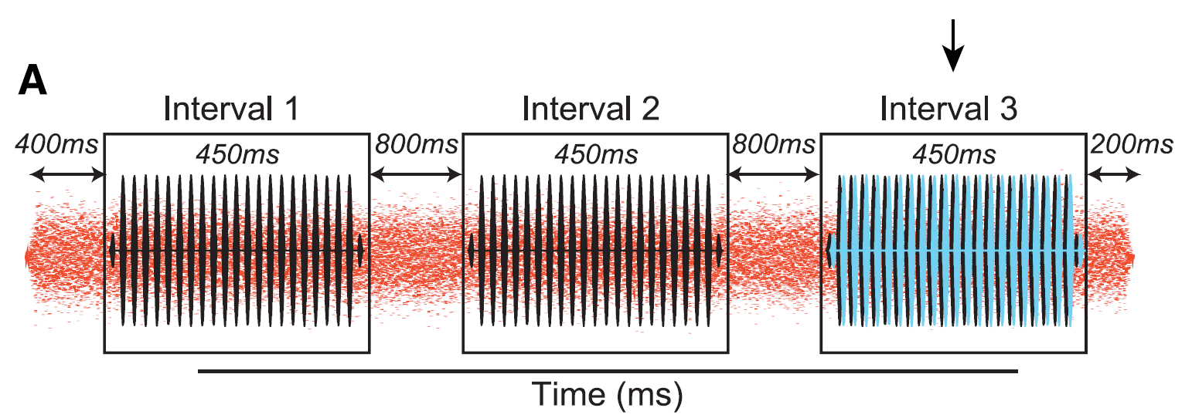
Wave V Latency in Noise (in humans)
Mehraei (16)
Psychophysical Task: Identify a Interaural Time Difference (ITD) shift in the second or third interval of a signal-in-notched-noise presentation ➔ ITD in noise threshold.
Target at 80dB to really recruit low SR fibers
23 subjects with normal (within 15dB) thresholds, “normal” ABRs. (Mehraei et. al, 2016)
Notes:
Goal: make a psychophysical task that really challenges low-SR fibers

Slide 32
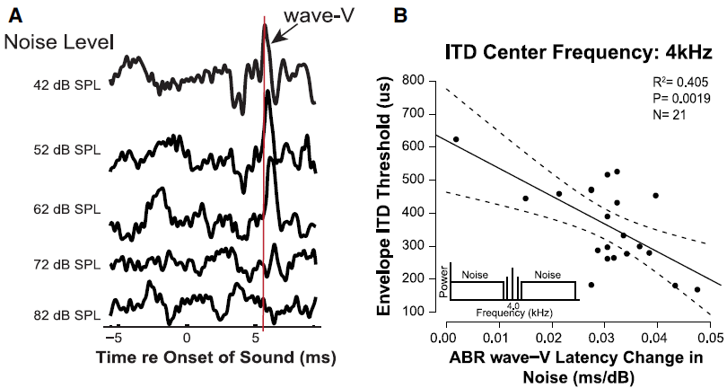
Wave V Latency in Noise (in humans)
Mehraei (16)
Wave V latency changes in click-evoked ABRs correlate with performance differences, even in “normal” listeners.
→ A candidate for an objective measure

Slide 33
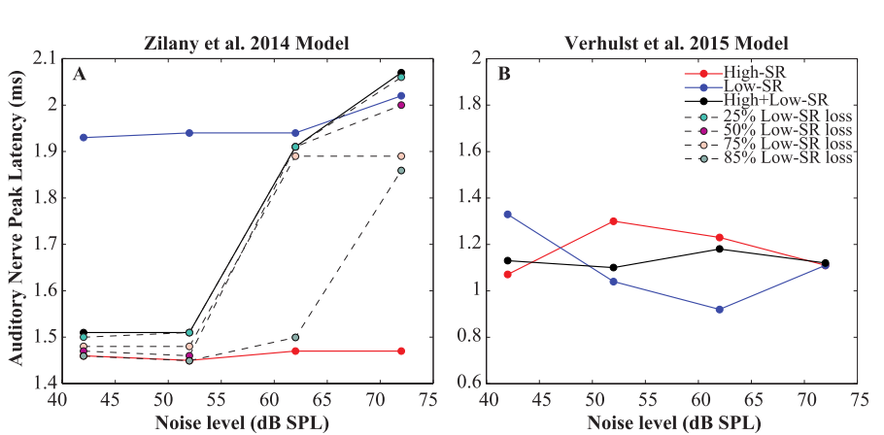
Modeling this task was inconclusive

Slide 34
How do Models Affect HHL Estimates
Use Noise-Masked clicktrains to get ABR estimates
Why do they differ from previous models?
240 combinations of parameters were simulated
250 GB of results
Challenge: How do you visualize the effects of discrete changes in parameters with 6 dimensions?
For this work, we can always plot
Wave V Latency vs. Noise Masker Level
Wave I Peak Amplitude vs. Noise Masker Level.
And rove the other parameters.
Run it. Wait 9 days. Plot the results!

Slide 35
Effects of Synaptopathy
Notes:
Surprisingly, not very much. Verhulst model predicts more wave V latency than zilany, but changes are in tenths of milliseconds.
Wave I amplitudes decrease as expected.

Slide 36
Effects of Peripheral Model

Slide 37
Effects of CF Weighting

Slide 38
Effects of Brainstem/Midbrain

Slide 39
Summary
A modeling framework was built.
Direct comparisons between different models are possible.
Easily managed results
Results plotted on the fly
The framework was used to explore the effects of model parameters on the fidelity of modeling human results
CF-weighting, Brainstem, Periphery and Synaptopathy effects suggest interesting ways of thinking about low-SR fiber contributions
CF Weighting → modest effect
Complex brainstem → modest effect
Periphery → modest effect.

Slide 40
Future Work
More complex models of hearing loss: Notches, noise-induced pathologies, etc.
Synaptopathy may depend on fiber stochasticity
Look to off-frequency effects?
Should IC model parameters vary?
How clever can we be about parameter sampling?
Framework improvements
Easier configuration of synaptopathies
Publication to PyPi: the Python Package Index
“Experiment Creator” wizard.

Slide 41
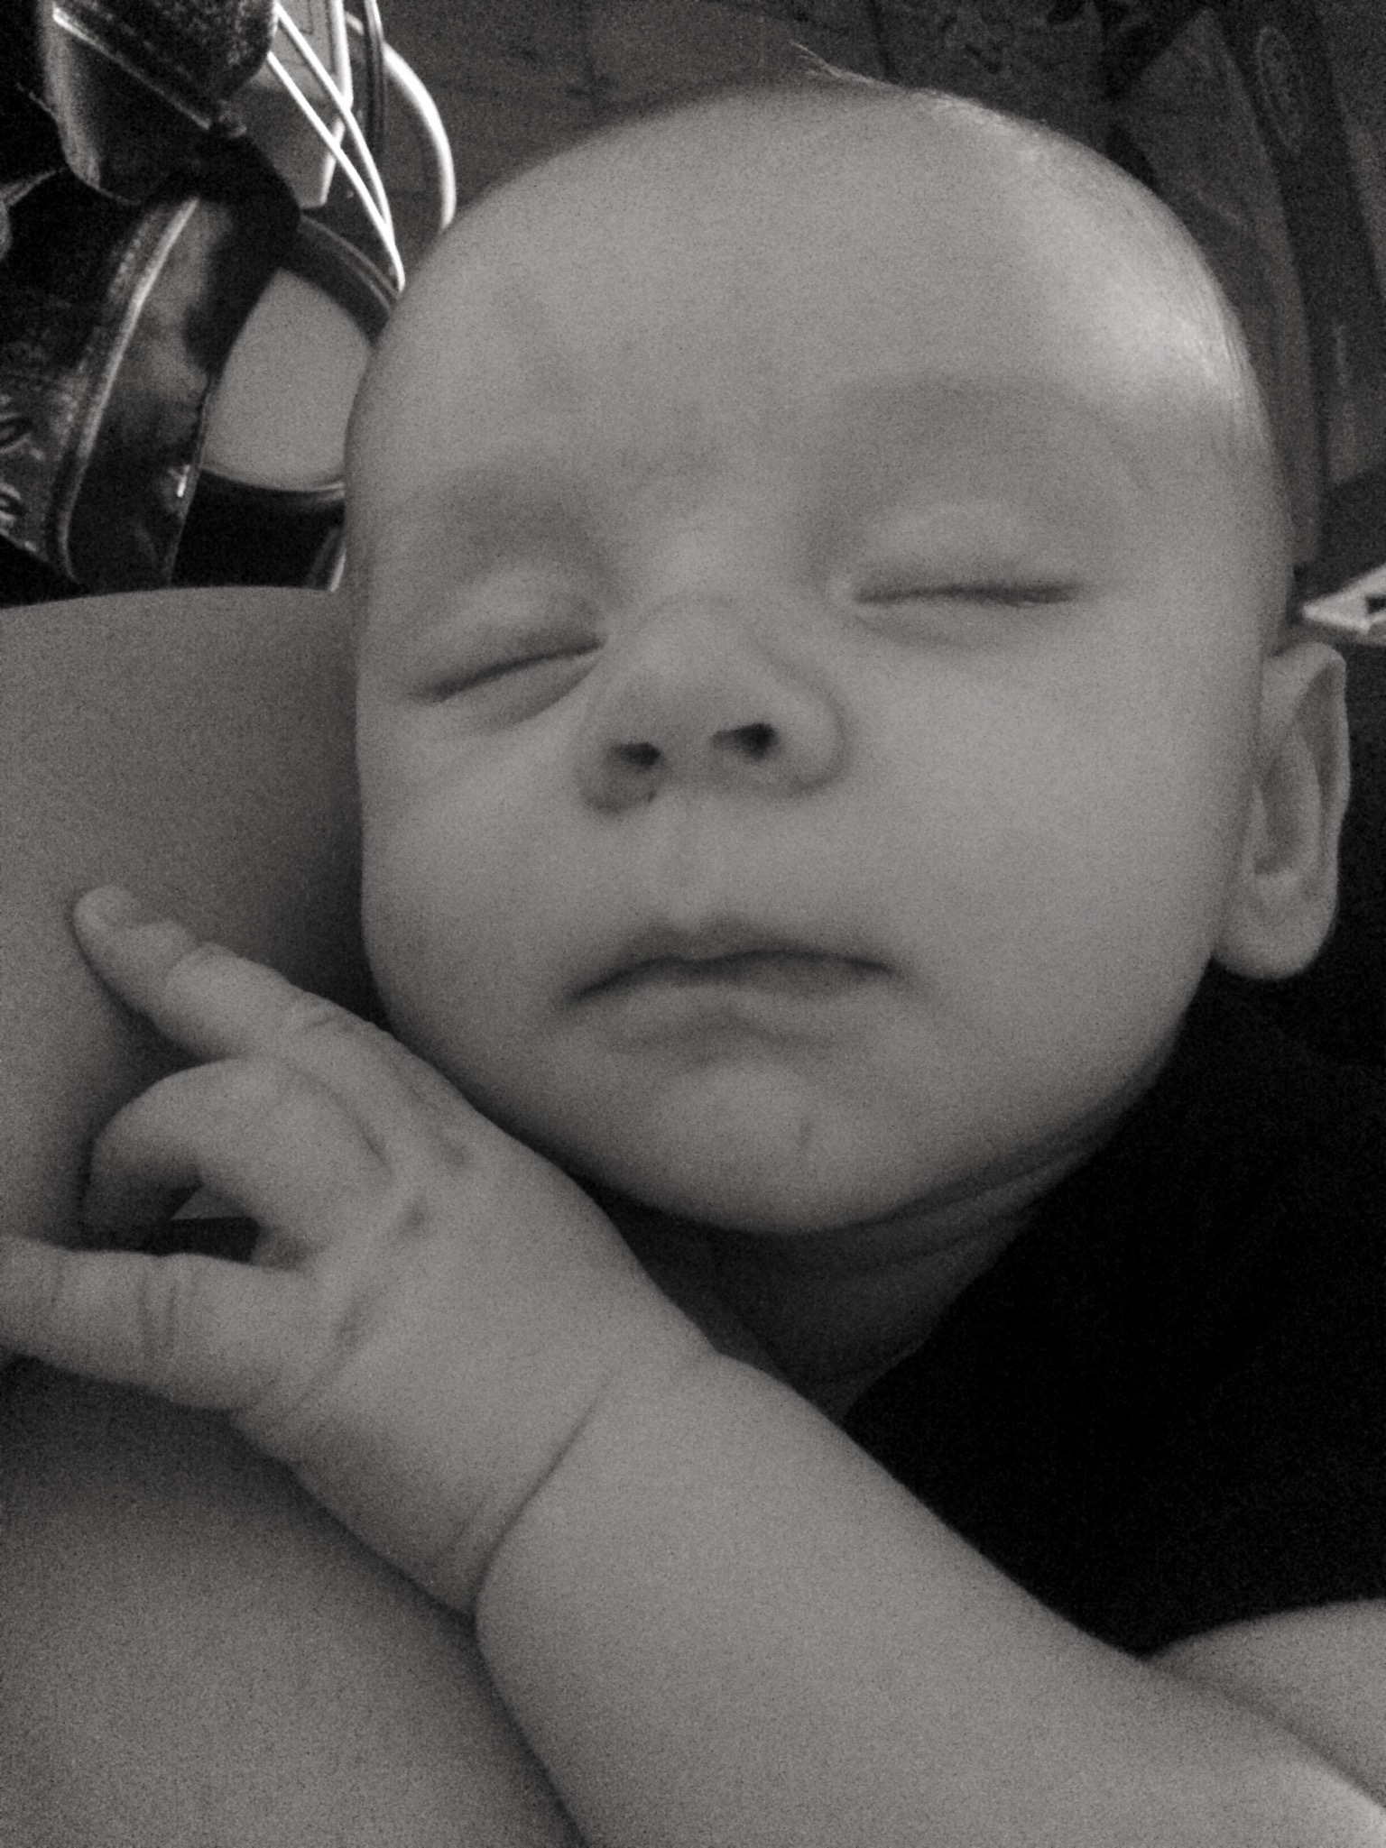
Acknowledgements
Committee
Steve Colburn
Barb Shinn-Cunningham
Allyn Hubbard
Heidi Nakajima
BU Alumni and Visitors
Sarah Verhulst
Laurel Carney
Gerard Encina-Llamas
Daryl Kelvasa
Auditory Biophysics Lab
Dave Mountain
Dave Anderson
Aleks Zosuls
Andy Brughera
Personal
Yelena
Rory
Helen
Stephen
Ian
V
Friends!
Auditory Neuroscience Lab
Goldbarg Mehraei
Le Wang

Slide 42


Slide 43
